Slide 1
Year 1 Phonics Screening
Parents Meeting
Wednesday 5th February 2025
Mrs Davies – Phase 1 Lead and English Coordinator
Mrs Bartlett - Phonics and Early Reading Coordinator
Notes:
1
We know that Read Write Inc:
is rooted in synthetic phonics.
has been tried and tested over and over again
is systematic, structured and therefore results in rapid teaching and learning of sounds & blending
means that, importantly and simply, when children know these sounds well and they can blend, they read books that are carefully matched to the sounds they know. Which means that children are successful from the very beginning!
gave all staff 2 whole days intensive training to teach the programme
Quote from Ruth:
“When children can’t read there is low self esteem. We want them to be reading with confidence, to be able to read quite sophisticated texts at an early age.”
Ruth Miskin – former headteacher and creator of Read Write Inc Phonics

Slide 2
What is Phonics?
Children are taught to read by breaking down words into separate sounds or ‘phonemes’.
In their Phonics lessons, children are encouraged to read and write using new sounds they have learnt.
There are around 40 different sounds.
Notes:
2
Quote from Ruth:
“When children can’t read there is low self esteem. We want them to be reading with confidence, to be able to read quite sophisticated texts at an early age.”
Ruth Miskin – former headteacher and creator of Read Write Inc Phonics

Slide 3
What does a typical lesson look like?
All phonics sessions follow the same format:
Revisit – previous sounds/words
Teach – introduce a new sound
Practise – reading words with the new sound in
Apply – writing words and putting it into a sentence
Notes:
3
In using Read Write Inc. we will ensure two things: That new children who come to our school read fluently by the age of 7. It also catches those children who have already slipped through the net; those who are struggling. Read Write Inc. teaches all these children to read. EAL, SEN, dyslexic children also learn on this programme.

Slide 4
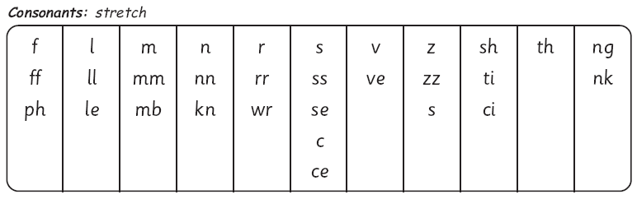
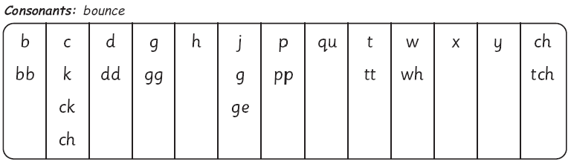
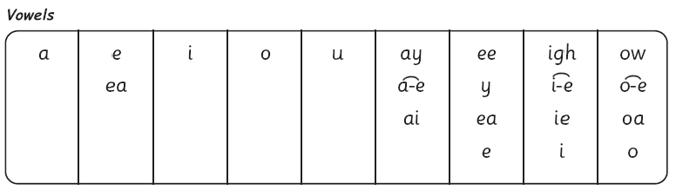
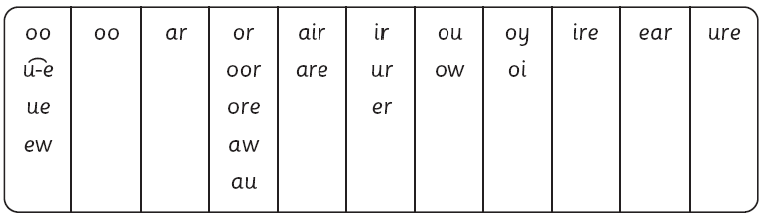
The complex English alphabetic code
Notes:
4
This chart shows the most usual graphemes for the 44 sounds
Explain that each box is a sound box showing different ways to read and write the sound. Demo with or sound box with e.g.s of words or, door, more, dawn, author.

Slide 5
Why are children being screened?
Every Year 1 child in the country will be taking the Phonics screening check in the same week in June.
The aim of the check is to ensure that all children can read by the end of Year 2.
It is to check their level at the end of Year 1 so support can be put into place during Year 2 if needed.
The children who do not pass their screening check will do it again in Year 2.
The check has been designed so that children with different abilities can take part.
Notes:
5
Explain that in English we have more 150 ways to represent 44 sounds using our 26 alphabet letters so groups of letters are used as well as single letters – these are called graphemes. Explain that we will teach the 100 most commonly used graphemes for the 44 sounds. But we will teach them systematically and very thoroughly.

Slide 6
Phonics Screening Check
Week beginning 9th June
1:1 with an adult in a quiet room
40 words to read
Mixture of real words and alien words
Previous pass mark has been 32/40
The children have been asked to do very similar tasks in Phonics lessons and we practise with them so it won’t be new for them.
Key to success:
Look for the special friends in the word first, draw sound buttons on, sound out the word and blend.
Notes:
6
Explain that in English we have more 150 ways to represent 44 sounds using our 26 alphabet letters so groups of letters are used as well as single letters – these are called graphemes. Explain that we will teach the 100 most commonly used graphemes for the 44 sounds. But we will teach them systematically and very thoroughly.

Slide 7
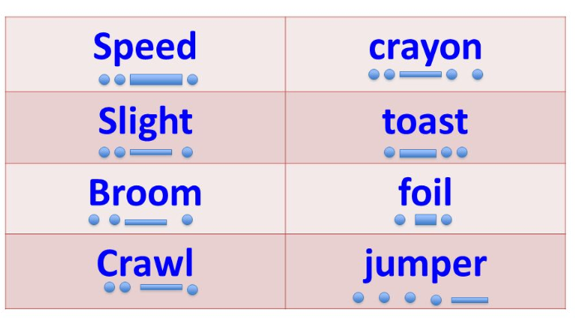

Sound Buttons
Used to identify phonemes/sounds in words
Three different types
Notes:
7
Explain that in English we have more 150 ways to represent 44 sounds using our 26 alphabet letters so groups of letters are used as well as single letters – these are called graphemes. Explain that we will teach the 100 most commonly used graphemes for the 44 sounds. But we will teach them systematically and very thoroughly.

Slide 8






Real Words
Here are some examples of the words that were in the Phonics Screening Check in previous years.
Notes:
8
First of all, you can help your child if you know how to pronounce the 44 sounds perfectly and understand the blending process.
There are lots of other ways but 1st let’s look at the 44 sounds, then the ways we read and write those sounds and then meet Fred!

Slide 9
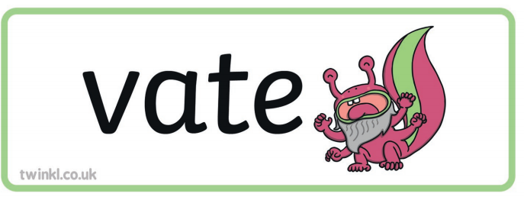


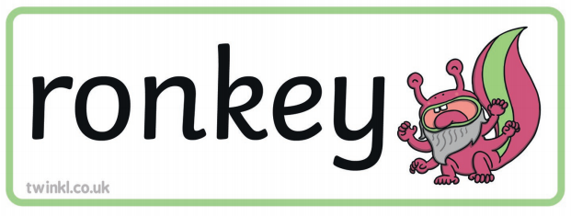
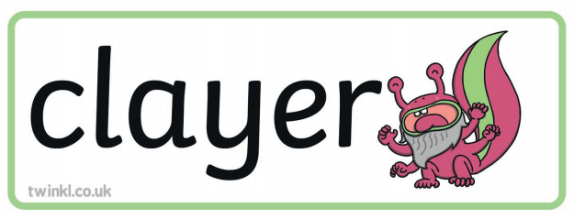

What are Alien Words?
Words that must be decoded through application of phonic skills. These words do not make sense. Children make call these words alien words or nonsense words. These will be clear to your child during the phonics screening test so they know what is an alien word and what is not.
Notes:
9
First of all, you can help your child if you know how to pronounce the 44 sounds perfectly and understand the blending process.
There are lots of other ways but 1st let’s look at the 44 sounds, then the ways we read and write those sounds and then meet Fred!

Slide 10
How can you help your child?
Familiarise yourself with the sounds
Familiarise yourself with the sayings that accompany the sounds er – better letter, ir – whirl and twirl, ur – nurse with a purse
By saying the sounds as pure sounds – no ‘errrrr’
Understanding special friend sounds
Look for any special friends in words first
Draw the sound buttons underneath
Breaking down longer words into their syllables e.g. chapter.
Continue reading with your children each night which will encourage them to sound out words, ask questions about the story. This Phonics check does not include comprehension about stories.
Most importantly, enjoy reading together!
Notes:
10
First of all, you can help your child if you know how to pronounce the 44 sounds perfectly and understand the blending process.
There are lots of other ways but 1st let’s look at the 44 sounds, then the ways we read and write those sounds and then meet Fred!

Slide 11
Useful Websites
Lettersandsounds.com – games to help revise all phase 5 sounds
Gov.uk – past Phonics screening papers
https://www.oxfordowl.co.uk/for-home/find-a-book/read-write-inc-phonics--1/ - videos of sounds being taught and additional resources
Phonics play – www.phonicsplay.co.uk
Top Marks – www.topmarks.co.uk
Notes:
11
First of all, you can help your child if you know how to pronounce the 44 sounds perfectly and understand the blending process.
There are lots of other ways but 1st let’s look at the 44 sounds, then the ways we read and write those sounds and then meet Fred!

Slide 12
Key Vocabulary
Grapheme – written representation of a sound
Phoneme - a sound
Diagraph – two letters that make one sound e.g. ai as in rain
Split diagraph – two letters that make one sound, split up by another letter a-e, e-e, i-e, u-e, o-e
Trigraph – three letters that make one sound e.g. ear as in fear
Special friends – diagraphs or trigraphs or double letters tt, ck
Blending – the squashing of sounds together for reading
Segmenting – the breaking down of a word into its individual sounds for spelling
Syllables – the beats in a word
Notes:
12
we know that Read Write Inc:
is rooted in synthetic phonics.
has been tried and tested over and over again
is systematic, structured and therefore results in rapid teaching and learning of sounds & blending
means that, importantly and simply, when children know these sounds well and they can blend, they read books that are carefully matched to the sounds they know. Which means that children are successful from the very beginning!
gave all staff 2 whole days intensive training to teach the programme
Quote from Ruth:
“When children can’t read there is low self esteem. We want them to be reading with confidence, to be able to read quite sophisticated texts at an early age.”
Ruth Miskin – former headteacher and creator of Read Write Inc Phonics

