Slide 1
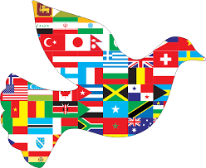
Peace in Europe
Collective Worship in response to the Russia: Ukraine Conflict

Slide 2
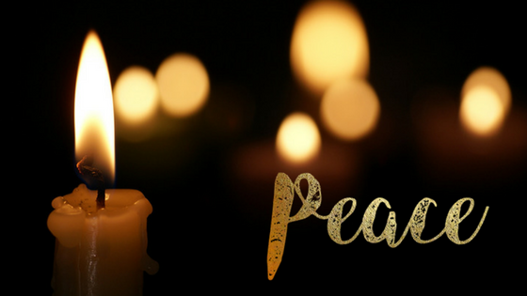
Welcome
We gather together as a school family in peace to think about what is happening in the world and to remember the importance of hope and love. We say thank you for our safety and think about those who are not safe today.

Slide 3

The country of Ukraine has been invaded

Slide 4
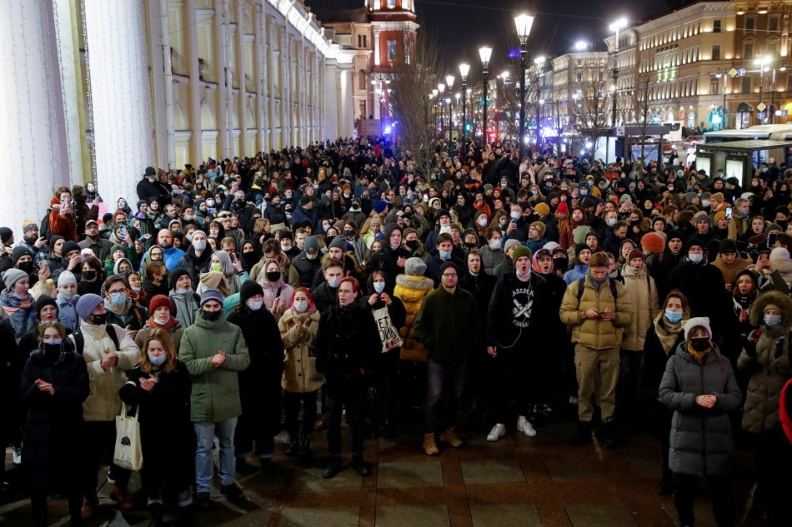
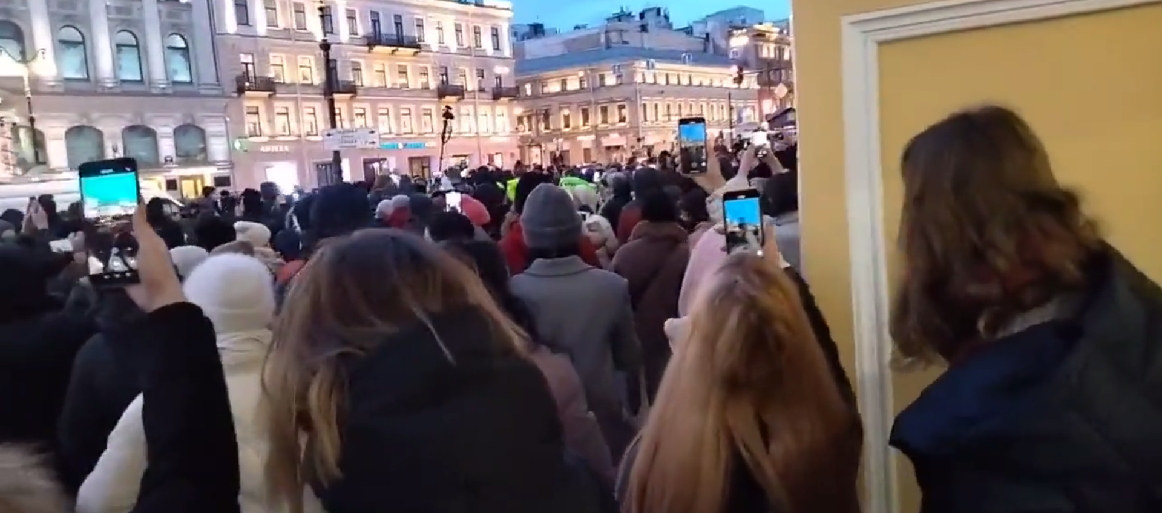
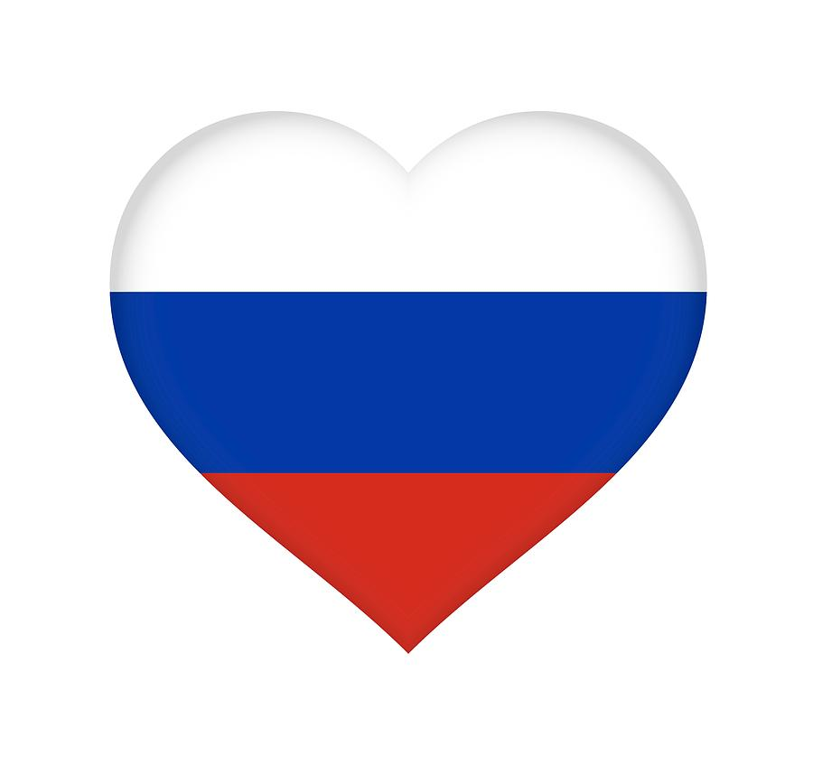
Many of the people of Russia do not want a war

Slide 5
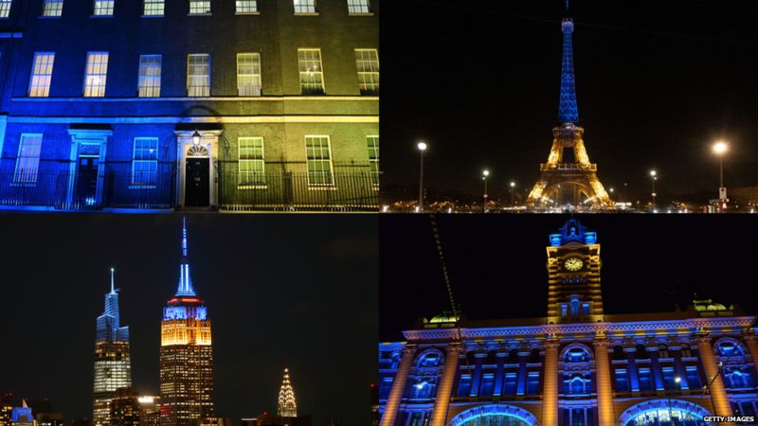

Slide 6
What is a sanction?
A sanction is a penalty applied to a country by another when they are seen to be doing something wrong
They can also be set against companies, organisations or even individual people
They are imposed in an attempt to change a country's government's behaviour
They are one of the toughest measures a country can take, short of going to war
They are often financial, so about money - for example, a country may say they'll stop trading with another, which impacts how much money that country can make

Slide 7
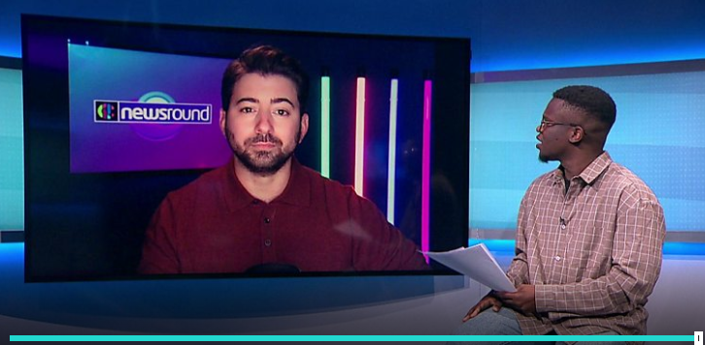
https://www.bbc.co.uk/newsround/60520226

Slide 8

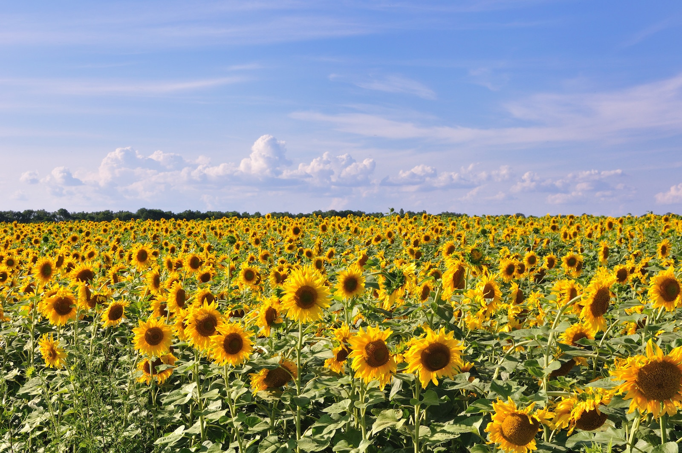
The sunflower is the national flower of Ukraine. To show our support for the people of Ukraine, we will all plant a sunflower this term.

Slide 9
Reflection
We can all be peacemakers. It is a good way to live.
There is not peace on our continent right now. We have leaders who are not choosing peace but we hope they soon will.
We open our hearts to a peace and pray that the people of Ukraine can live in peace again soon.

